Slide 1
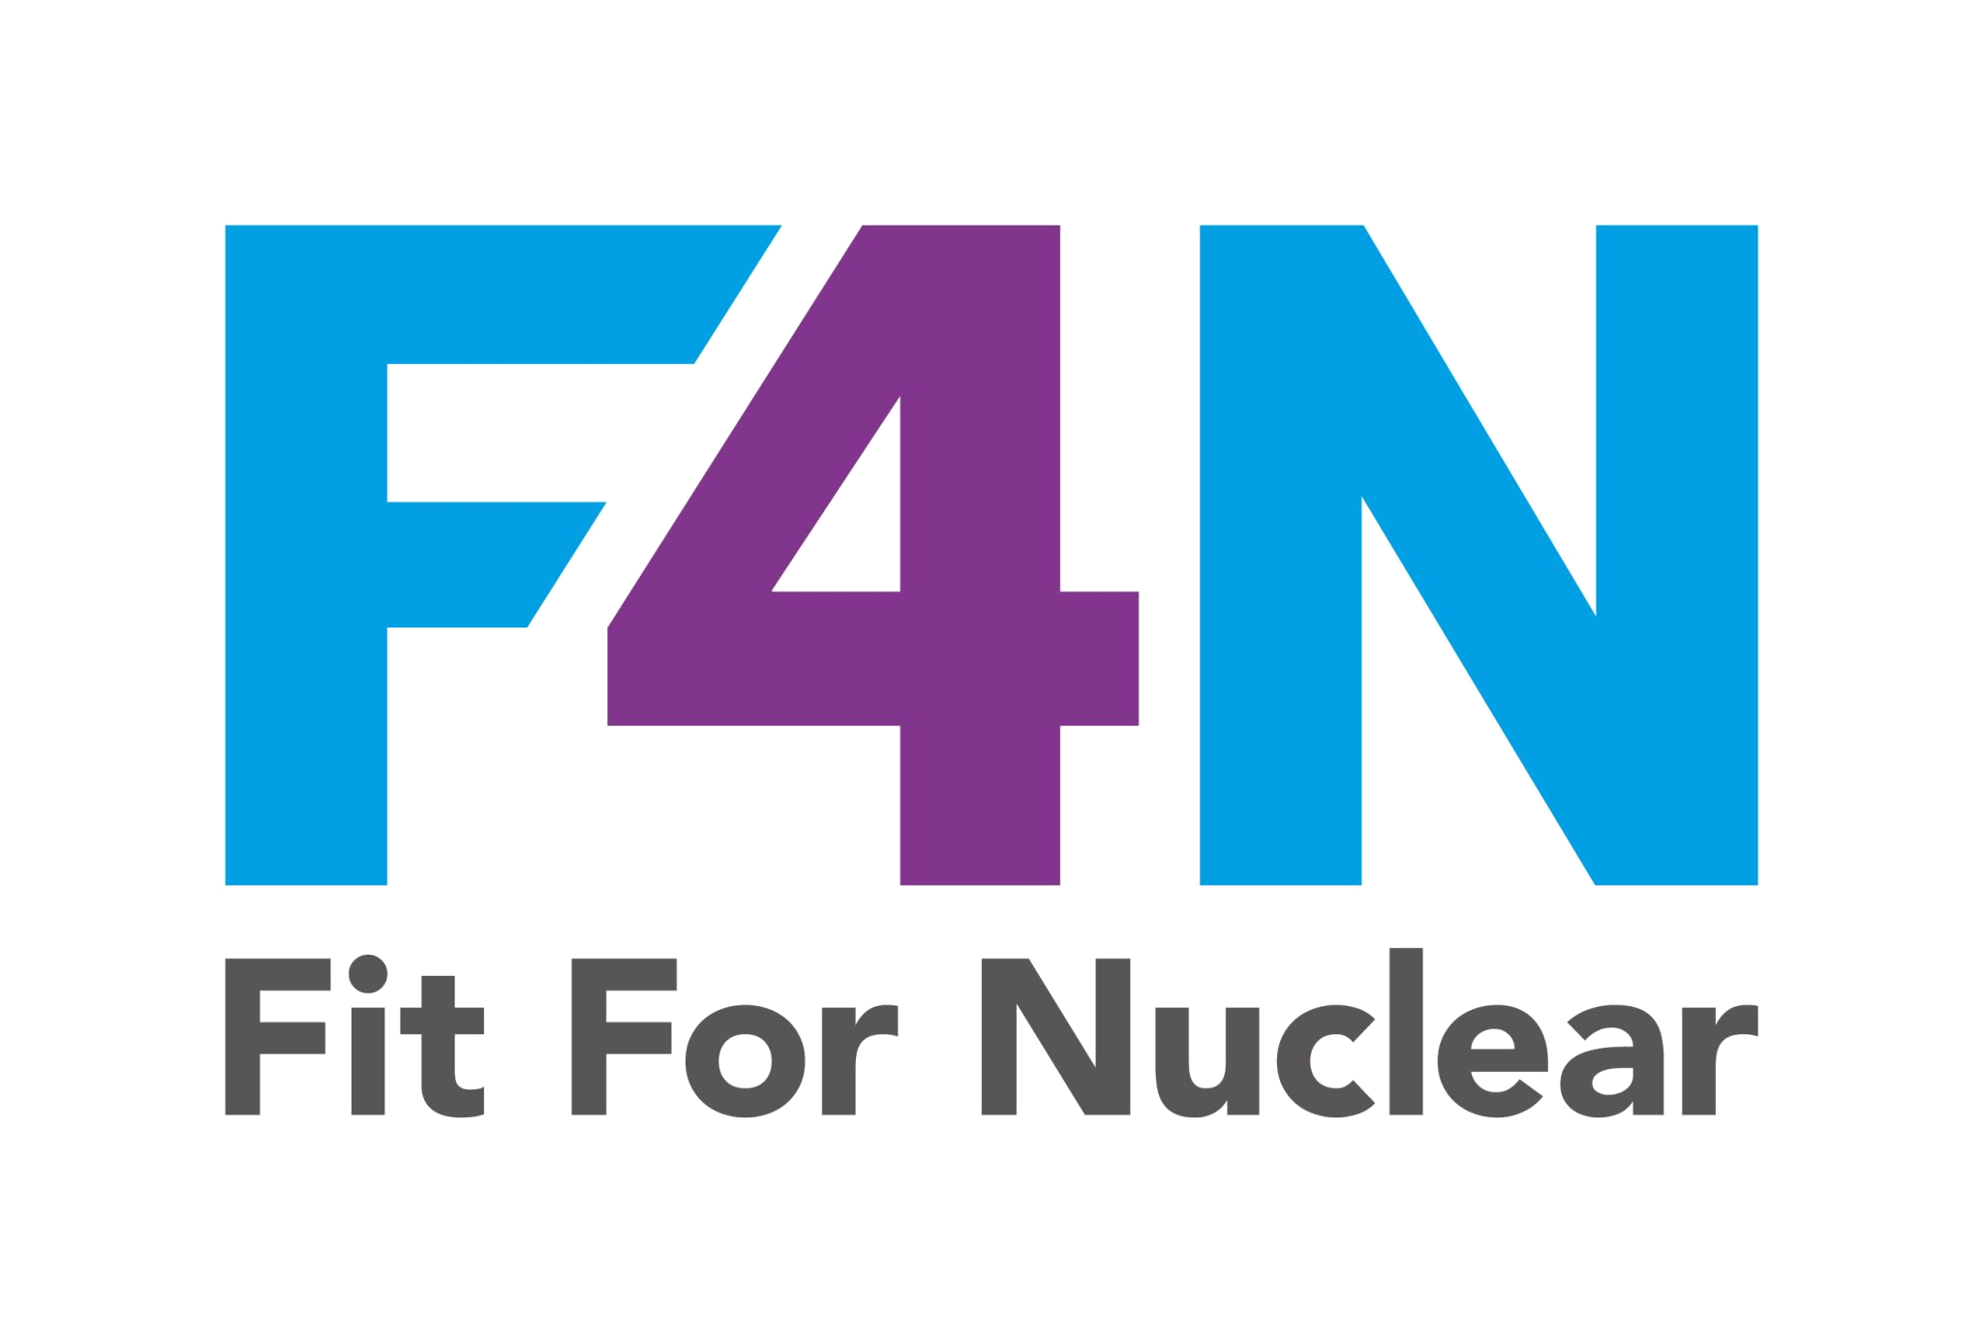

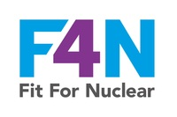
NUCLEAR GOVERNANCE
Nuclear Leadership and Governance
What it means for our organisation and why it matters
NucCol | Nuclear Collaboration Ltd · Fit For Nuclear Programme · Commercial in Confidence | 1

Slide 2

What Nuclear Governance Is
Nuclear governance means having clear, documented accountabilities for nuclear safety quality in our organisation
It means specific people holding specific authorities for nuclear decisions, not everyone and no one at the same time
It is what gives our nuclear clients and ONR confidence that someone is genuinely in charge of quality on our nuclear work
This is required by ISO 19443 and assessed during F4N, client audits, and ONR supply chain inspections
It is different from our general business governance, which is covered in our BE programme
Nuclear governance is not bureaucracy. It is the structure that ensures nuclear safety decisions are made by the right person, with the right information, at the right time.
NSS-04g | NUCLEAR GOVERNANCE
NucCol | Nuclear Collaboration Ltd · Fit For Nuclear Programme · Commercial in Confidence | 2

Slide 3

Who Holds Nuclear Accountability in Our Organisation
Nuclear Executive Sponsor: [Director Name]. Overall accountability for nuclear safety quality. Signs our commitment statement.
Nuclear Quality Lead: [Name]. Day-to-day QMS ownership. Authority to stop work. Approves NCR dispositions.
Nuclear Safety Champion: [Name, if applicable]. Operational advocate for safety culture. Leads walkdowns.
Independent Concerns Contact: [Name]. The person any of us can go to with a nuclear concern if we are not comfortable raising it with our direct manager
Each of these roles has specific authorities and accountabilities defined in our Nuclear Governance Framework (NSS-04b)
Check the NSS-04b Nuclear Governance Framework for the full list of named individuals and what they are specifically accountable for.
NSS-04g | NUCLEAR GOVERNANCE
NucCol | Nuclear Collaboration Ltd · Fit For Nuclear Programme · Commercial in Confidence | 3

Slide 4

What Visible Nuclear Leadership Looks Like
Leaders conduct planned nuclear safety walkdowns: structured visits to work areas to observe nuclear quality practices
Nuclear quality is a standing agenda item at management meetings, not an occasional topic
When a nuclear quality concern is raised, the response is visible and the person who raised it is told the outcome
Conservative decisions are made openly and explained: choosing the safe option over the schedule option
Our Nuclear Safety Leadership Commitment Statement is displayed and means something, not just a document on a wall
Visible nuclear leadership is what transforms governance documents into genuine safety culture.
NSS-04g | NUCLEAR GOVERNANCE
NucCol | Nuclear Collaboration Ltd · Fit For Nuclear Programme · Commercial in Confidence | 4

Slide 5

How Nuclear Decisions Are Made
Not every decision requires director approval, but every nuclear decision type has a defined authority level
Material certificate anomalies: Nuclear Quality Lead has authority to reject. If Grade 1, director is notified.
Concessions on nuclear NCRs: Nuclear Quality Lead approves technically. Director endorses. Client agrees.
Releasing nuclear product: Nuclear Quality Lead signs off. Client QA at contracted hold points.
Stopping work for nuclear quality: Any of us can raise a stop-work concern. Nuclear Quality Lead has the authority to act on it. No commercial override.
When in doubt about a decision: escalate to Nuclear Quality Lead rather than making an informal call
The Nuclear Governance Framework defines exactly who decides what. If you are ever unsure, ask rather than assume.
NSS-04g | NUCLEAR GOVERNANCE
NucCol | Nuclear Collaboration Ltd · Fit For Nuclear Programme · Commercial in Confidence | 5

Slide 6

What You Should Expect to See and Do
Planned safety walkdowns by leaders: look out for them, engage with them, answer questions honestly
Nuclear quality updates in team briefings: listen and act on any relevant information
The Nuclear Safety Leadership Commitment Statement on display: it represents a genuine commitment, not window dressing
A clear and trusted route to raise concerns: if you are uncomfortable raising something with your direct manager, you can go to [Independent Concerns Contact Name] directly
If you witness something that does not look right for a nuclear application: stop, report it, and do not proceed until it is resolved
Good governance only works when everyone in the organisation plays their part.
NSS-04g | NUCLEAR GOVERNANCE
NucCol | Nuclear Collaboration Ltd · Fit For Nuclear Programme · Commercial in Confidence | 6

Slide 7
Discussion Scenario
SCENARIO
A production manager is under pressure to deliver a batch for a nuclear contract by end of week. The Nuclear Quality Lead has raised an NCR on one of the items and has not yet agreed a disposition. The production manager suggests 'just sending it and sorting the paperwork afterwards'.
DISCUSS:
What does our nuclear governance structure say about this situation? Who has the authority to decide what happens next? What should you do if you are the production manager?
NSS-04g | NUCLEAR GOVERNANCE
NucCol | Nuclear Collaboration Ltd · Fit For Nuclear Programme · Commercial in Confidence | 7

Slide 8
Nuclear governance is not about paperwork. It is about who is accountable, who decides, and whether we all trust the system enough to use it.
NSS-04g | NUCLEAR GOVERNANCE
NucCol | Nuclear Collaboration Ltd · Fit For Nuclear Programme · Commercial in Confidence | 8

